Slide 1


Pokhara University and Madan Bhandari Memorial Academy Nepal
(Joint constituent college)
Madan Bhandari College of Engineering
Urlabri-03, Morang
Project (II) Proposal Defence on:-
“ Smart City Information Portal ”
Submitted By Submitted To
Raja Kumar Sah Department of Computer Engineering
Dipesh Kumar Mahato
Bunu Khatiwada
Kajjal Chamlagain

Slide 2
Introduction
A Smart City Information Portal is a web-based system that provides centralized access to city information and services. It improves communication, transparency, and efficiency in urban management through digital technology.

Slide 3
Problem Statement
Lack of a centralized digital platform for city information
Citizens face difficulty accessing updated public services
Communication gap between authorities and residents
Manual systems lead to delays and inefficiency

Slide 4
Objectives
To design and develop a centralized Smart City Information Portal.
To provide real-time city information and enhance citizen engagement through digital services.

Slide 5
Key Features
City announcements and notifications
Emergency services directory
Public service information system
Online complaint and feedback system
Event and facility updates
User-friendly dashboard interface

Slide 6
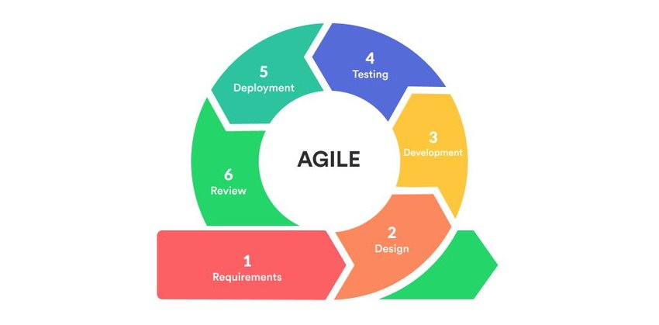
Methodology

Slide 7
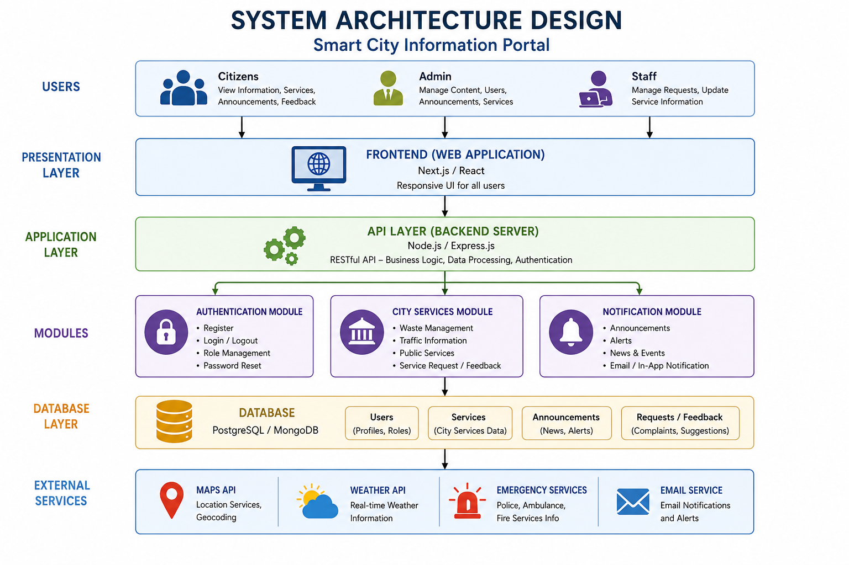

Slide 8
Technology Stack
Frontend: React.js, Tailwind CSS
Backend: Node.js, Express.js, JWT Authentication
Database: MongoDB, Cloudinary
Maps: Google Maps API
Real-Time: Socket.io, pusher

Slide 9
Expected Outcome
Efficient access to city information
Improved digital communication system
Faster service delivery and transparency
Contribution toward smart urban development

Slide 10
THANK YOU!!

